Slide 1
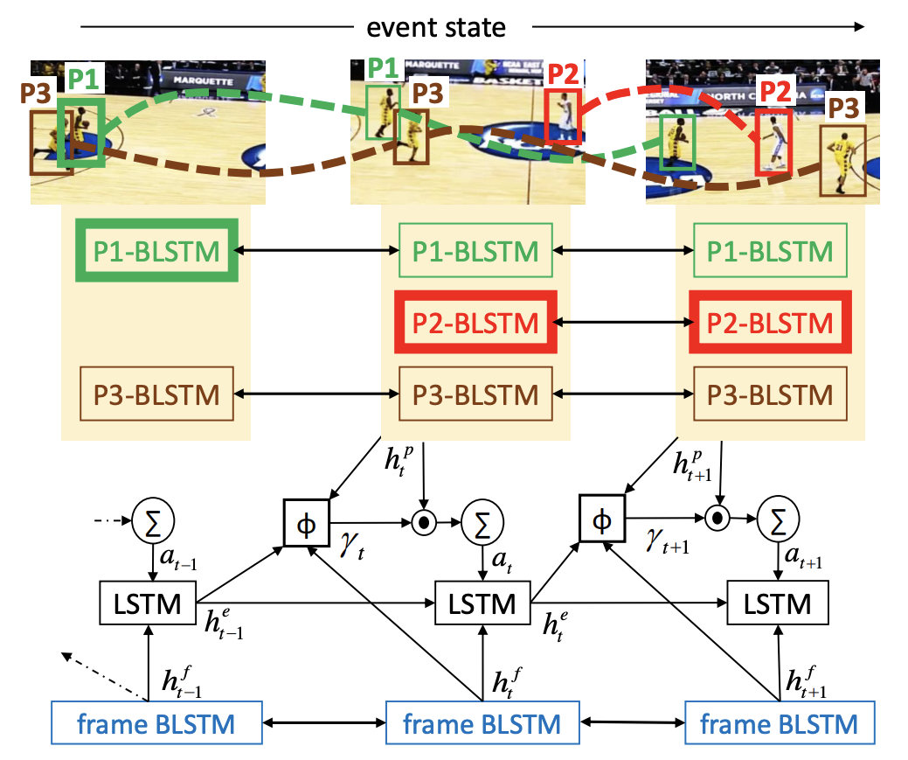
Video processing with deep learning
by Ron Weiner
vision.stanford.edu/pdf/ramanathan2016cvpr.pdf
1 / 45

Slide 2

About me
Co-Founder & CEO of Give & Tech non-profit organization.
An AI researcher and Consultant.
8200 alumni bachelor of Computer and Cognition science at the OpenU.
Working with data in the past 9 years.
Agenda: Nature is build of mathematical rules, therefore the answer is out there... To find the answer all we need to do is to use the right lens.
2 / 45

Slide 3
Day agenda
Common use cases in the video domain
Challenges in video domain
Common attitudes for video analysis
Self-supervision from videos - a technique to create better baseline weights
Video Summarization & scenes highlighting
Common use cases in the video domain
Challenges in Video domain
Common approaches for video analysis
Self-supervision from videos
Video Summarization & scenes highlighting
3 / 45

Slide 4


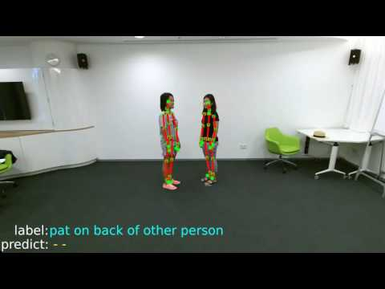
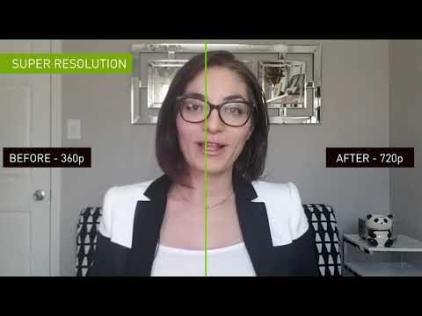
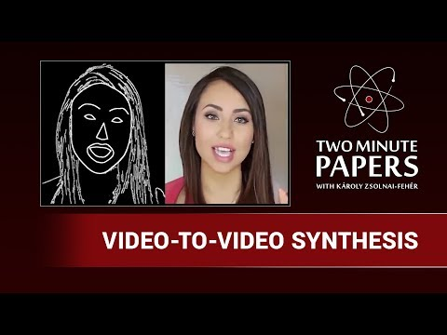
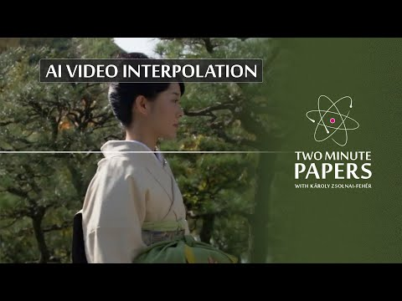
Common use cases in video domain
Common use cases in the video domain
Challenges in Video domain
Common approaches for video analysis
Self-supervision from videos
Video Summarization & scenes highlighting
4 / 45

Slide 5
Common use cases in video domain
Action recognition
Object tracking
Complete missing information (increase # fps)
Sound to object match (localization)
Predict next frame/sequence (generate videos)
Video summarization
Video to text (subtitles from sound & image)
Deep fake
Common use cases in the video domain
Challenges in Video domain
Common approaches for video analysis
Self-supervision from videos
Video Summarization & scenes highlighting
5 / 45

Slide 6
Common use cases in video domain
Great resources to begin with:
Video Datasets Overview
Awesome Deep Learning for Video Analysis
Google AI hub
Common use cases in the video domain
Challenges in Video domain
Common approaches for video analysis
Self-supervision from videos
Video Summarization & scenes highlighting
6 / 45

Slide 7
Day agenda
Common use cases in the video domain
Challenges in Video domain
Common attitudes for video analysis
Self-supervision from videos - a technique to create better baseline weights
Video Summarization & scenes highlighting
Common use cases in the video domain
Challenges in Video domain
Common approaches for video analysis
Self-supervision from videos
Video Summarization & scenes highlighting
7 / 45

Slide 8
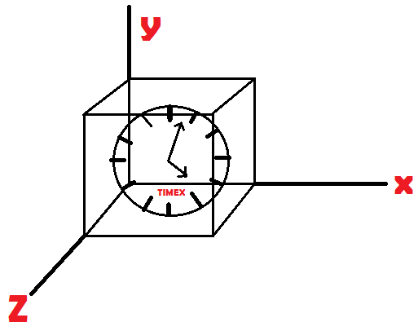
Challenges in Video domain
Computational burden
Lots of features to learn (time & space axis)
Varying length of video (do we work with fixed time window?)
Annotating can take a lot of time and money
Common use cases in the video domain
Challenges in Video domain
Common approaches for video analysis
Self-supervision from videos
Video Summarization & scenes highlighting
8 / 45

Slide 9
Challenges in Video domain
Computational burden
The reference dataset for image classification, ImageNet, has ~14M images
Training a state of the art CNN can take up to 2 weeks on a single GPU
Now imagine that we have an ‘ImageNet’ of 1.3M videos
Assuming videos of 30s at 24fps, we have 936M frames
This is 720x ImageNet!
Common use cases in the video domain
Challenges in Video domain
Common approaches for video analysis
Self-supervision from videos
Video Summarization & scenes highlighting
9 / 45

Slide 10
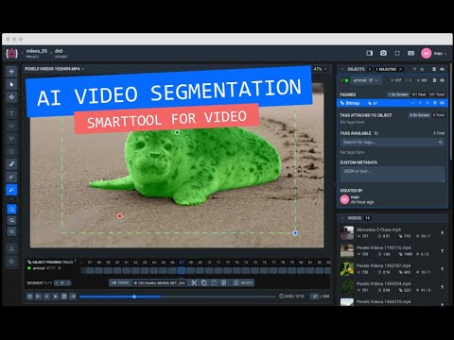
Challenges in Video domain
General tips (if possible)
Be creative to get more annotated data
Use transfer learning (maybe freeze trained layers)
Consider resize frames
Consider frames filtering (thanks to redundancy)
Consider frames selection (attention mechanisms)
Time axis can be a label
AI-powered video segmentation tool
Common use cases in the video domain
Challenges in Video domain
Common approaches for video analysis
Self-supervision from videos
Video Summarization & scenes highlighting
10 / 45

Slide 11
Day agenda
Common use cases in the video domain
Challenges in Video domain
Common attitudes for video analysis
Self-supervision from videos - a technique to create better baseline weights
Video Summarization & scenes highlighting
Common use cases in the video domain
Challenges in Video domain
Common approaches for video analysis
Self-supervision from videos
Video Summarization & scenes highlighting
11 / 45

Slide 12
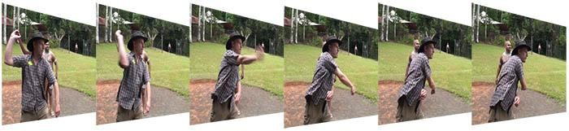
What is a video?
Formally, a video is a 3D signal
Spatial coordinates: x, y
Temporal coordinate: t
If we fix t, we obtain an image. We can understand videos as sequences of images (a.k.a. frames)
Common use cases in the video domain
Challenges in Video domain
Common approaches for video analysis
Self-supervision from videos
Video Summarization & scenes highlighting
12 / 45

Slide 13
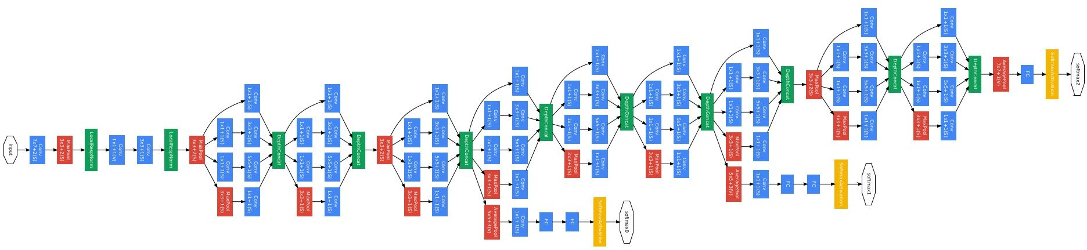
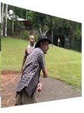
How do we work with images?
2D Convolutional Neural Networks (CNN) provide state of the art performance on image analysis tasks
Can we extend 2D CNNs expertise to image sequences?
Common use cases in the video domain
Challenges in Video domain
Common approaches for video analysis
Self-supervision from videos
Video Summarization & scenes highlighting
13 / 45

Slide 14
General notes for video analysis
The fusion dilemma
Optical flow
Common use cases in the video domain
Challenges in Video domain
Common approaches for video analysis
Self-supervision from videos
Video Summarization & scenes highlighting
14 / 45

Slide 15
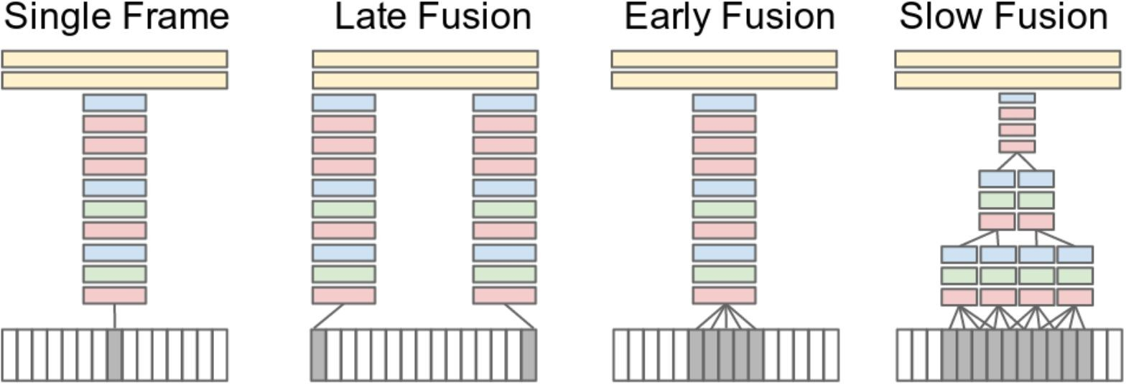
The fusion dilemma
There are multiple approaches
Single input (frame)
Karpathy, A., Toderici, G., Shetty, S., Leung, T., Sukthankar, R., & Fei-Fei, L. . Large-scale video classification with convolutional neural networks. CVPR 2014
Common use cases in the video domain
Challenges in Video domain
Common approaches for video analysis
Self-supervision from videos
Video Summarization & scenes highlighting
15 / 45
Notes:
every gray block is an input

Slide 16
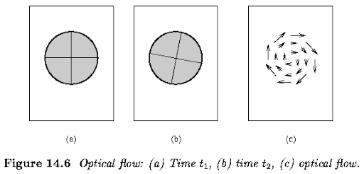
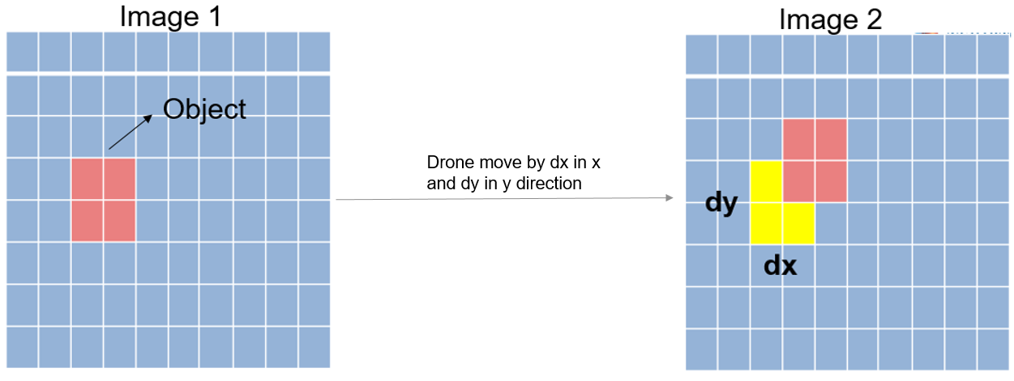
Optical flow
An algorithmic calculation which receive two consecutive frames and return a 2D vector field where each vector is a displacement vector showing the movement of points from first frame to second. The arrow shows its displacement vector. Assuming that pixel intensities of an object are constant between consecutive frames.
Common use cases in the video domain
Challenges in Video domain
Common approaches for video analysis
Self-supervision from videos
Video Summarization & scenes highlighting
16 / 45

Slide 17
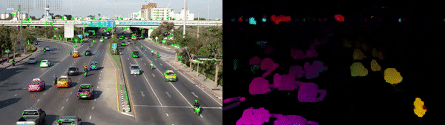
Sparse vs Dense Optical Flow
“Sparse optical flow gives the flow vectors of some "interesting features" (say few pixels depicting the edges or corners of an object) within the frame while Dense optical flow, which gives the flow vectors of the entire frame (all pixels) - up to one flow vector per pixel. As you would've guessed, Dense optical flow has higher accuracy at the cost of being slow/computationally expensive.” (nanonets)
Common use cases in the video domain
Challenges in Video domain
Common approaches for video analysis
Self-supervision from videos
Video Summarization & scenes highlighting
17 / 45
Notes:
add explanation about the dense post processing of the optical flow

Slide 18
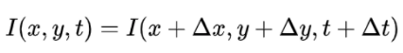
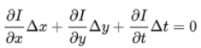
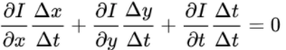
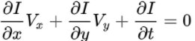
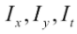
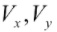
Optical flow
Assume the video is a 3D continuous and differentiable function and hence can be expand into a Taylor series around a certain pixel and time: (neglect the higher order terms)
Assuming all intensities of a moving object in the video remain the same:
We get:
Finally by ∆x,∆y,∆t dividing by ∆t we get the optical flow constraint for a pixel movement:
Where are the frame gradient (which we can calculate) and is the velocities of a certain pixel that we want to estimate.
Common use cases in the video domain
Challenges in Video domain
Common approaches for video analysis
Self-supervision from videos
Video Summarization & scenes highlighting
18 / 45
Notes:
get 2 frames and gives vectorial field

Slide 19
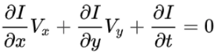
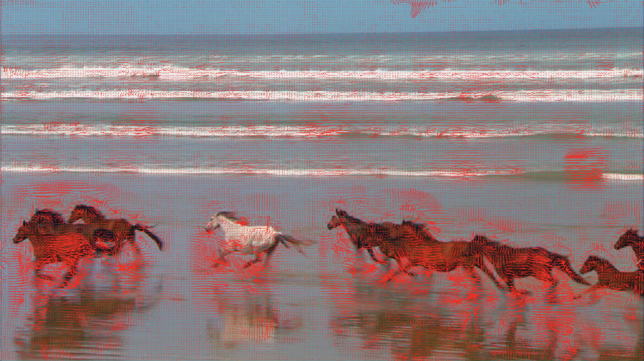
Optical flow
These equations holds for a certain pixel: (one linear equation with two variables)
Lucas-Kanade (sparse optical flow): Practically we take salient\corner points and assume that pixels in and around them have same movement and hence gain several linear constraints to solve optical flow.
Common use cases in the video domain
Challenges in Video domain
Common approaches for video analysis
Self-supervision from videos
Video Summarization & scenes highlighting
19 / 45
Notes:
get 2 frames and gives vectorial field

Slide 20
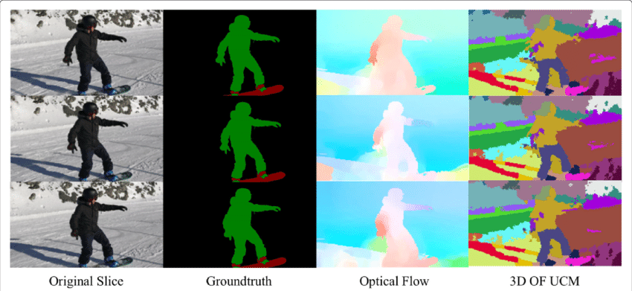
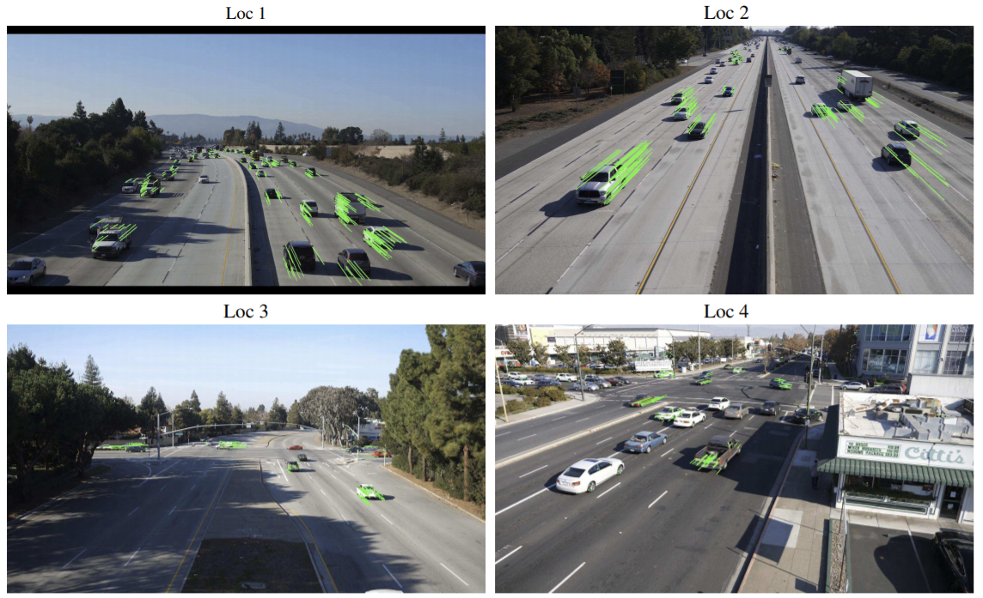
Optical flow - possible applications
Semantic Segmentation
Object Detection & Tracking
Common use cases in the video domain
Challenges in Video domain
Common approaches for video analysis
Self-supervision from videos
Video Summarization & scenes highlighting
20 / 45
Notes:
get 2 frames and gives vectorial field

Slide 21
Common attitudes for video analysis
Here are several simple and common implementations:
Single frame models + simple post processing (e.g majority vote)
CNN + RNN
3D convolutions
Two-stream CNN
Each method leverages the temporal information in a different way
Common use cases in the video domain
Challenges in Video domain
Common approaches for video analysis
Self-supervision from videos
Video Summarization & scenes highlighting
21 / 45

Slide 22
Single frame models - trivial solution
Combination method
Combination is commonly implemented as a small NN on top of a pooling operation (e.g. max, sum, average).
Drawback:
?
...
CNN
CNN
CNN
Ng et al., Beyond short snippets: Deep networks for video classification, CVPR 2015
Common use cases in the video domain
Challenges in Video domain
Common approaches for video analysis
Self-supervision from videos
Video Summarization & scenes highlighting
22 / 45

Slide 23
Single frame models - trivial solution
Combination method (dense / majority vote etc)
Combination is commonly implemented as a small NN on top of a pooling operation (e.g. max, sum, average).
Drawback:
Pooling is not aware of the temporal order!
...
CNN
CNN
CNN
Ng et al., Beyond short snippets: Deep networks for video classification, CVPR 2015
Common use cases in the video domain
Challenges in Video domain
Common approaches for video analysis
Self-supervision from videos
Video Summarization & scenes highlighting
23 / 45

Slide 24
CNN + RNN
...
...
RNN
RNN
RNN
Recurrent Neural Networks are well suited for processing sequences.
Drawback:
?
CNN
CNN
CNN
Donahue et al., Long-term Recurrent Convolutional Networks for Visual Recognition and Description, CVPR 2015
Common use cases in the video domain
Challenges in Video domain
Common approaches for video analysis
Self-supervision from videos
Video Summarization & scenes highlighting
24 / 45

Slide 25
CNN + RNN
...
...
RNN
RNN
RNN
Recurrent Neural Networks are well suited for processing sequences.
Drawback:
RNNs are sequential and cannot be parallelized.
Relatively long training time
CNN
CNN
CNN
Donahue et al., Long-term Recurrent Convolutional Networks for Visual Recognition and Description, CVPR 2015
Common use cases in the video domain
Challenges in Video domain
Common approaches for video analysis
Self-supervision from videos
Video Summarization & scenes highlighting
25 / 45

Slide 26
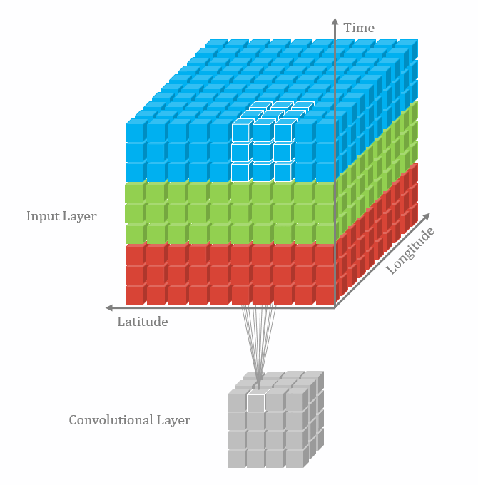
3D Convolutions: C3D
We can add an extra dimension to standard CNNs:
An image is a HxWxD tensor: MxNxD’ conv filters
A video is a TxHxWxD tensor: KxMxNxD’ conv filters
The video needs to be split into chunks (also known as clips) with a number of frames that fits the receptive field of the C3D. Usually clips have 16 frames.
Drawbacks:
?
Tran et al., Learning spatiotemporal features with 3D convolutional networks, ICCV 2015
Common use cases in the video domain
Challenges in Video domain
Common approaches for video analysis
Self-supervision from videos
Video Summarization & scenes highlighting
26 / 45

Slide 27
3D Convolutions: C3D
We can add an extra dimension to standard CNNs:
An image is a HxWxD tensor: MxNxD’ conv filters
A video is a TxHxWxD tensor: KxMxNxD’ conv filters
The video needs to be split into chunks (also known as clips) with a number of frames that fits the receptive field of the C3D. Usually clips have 16 frames.
Drawbacks:
How can we handle longer videos?
How can we use pre-trained networks?
Tran et al., Learning spatiotemporal features with 3D convolutional networks, ICCV 2015
Common use cases in the video domain
Challenges in Video domain
Common approaches for video analysis
Self-supervision from videos
Video Summarization & scenes highlighting
27 / 45

Slide 28
From 2D CNNs to 3D CNNs
3-D Convolutional Encoder-Decoder Network for Low-Dose CT via Transfer Learning From a 2-D Trained Network:
“Based on the transfer learning from 2D to 3D, the 3D network converges faster and achieves a better denoising performance than that trained from scratch.”
Read more here (3-D Convolutional Encoder-Decoder Network for Low-Dose CT via Transfer Learning From a 2-D Trained Network)
Common use cases in the video domain
Challenges in Video domain
Common approaches for video analysis
Self-supervision from videos
Video Summarization & scenes highlighting
28 / 45

Slide 29
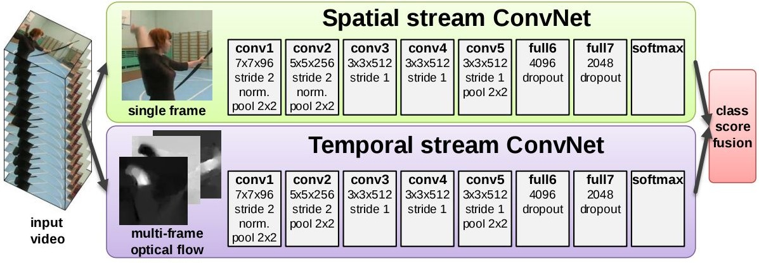
Two-stream CNNs
Single frame models do not take into account motion in videos. Proposal: extract optical flow for a stack of frames and use it as an input to a CNN.
Drawback: not scalable due to computational requirements and memory footprint.
Simonyan & Zisserman, Two-stream convolutional networks for action recognition in videos, ICCV 2015
Common use cases in the video domain
Challenges in Video domain
Common approaches for video analysis
Self-supervision from videos
Video Summarization & scenes highlighting
29 / 45

Slide 30
Day agenda
Common use cases in the video domain
Challenges in Video domain
Common attitudes for video analysis
Self-supervision from videos - a technique to create better baseline weights
Video Summarization & scenes highlighting
Common use cases in the video domain
Challenges in Video domain
Common approaches for video analysis
Self-supervision from videos
Video Summarization & scenes highlighting
30 / 45

Slide 31
Video annotation challenge
Neural Networks generally need a lot of annotated data just for calibration, but generating frame by frame annotations is expensive.
Hence, we want to find ways to first train a model for a different task in order to get to know the domain, based on a lot of non annotated samples and then fine tune this model for the original task with the annotated data.
Can we create some tasks for which we can get free annotations?
Yes! And videos are very convenient for this
Common use cases in the video domain
Challenges in Video domain
Common approaches for video analysis
Self-supervision from videos
Video Summarization & scenes highlighting
31 / 45

Slide 32
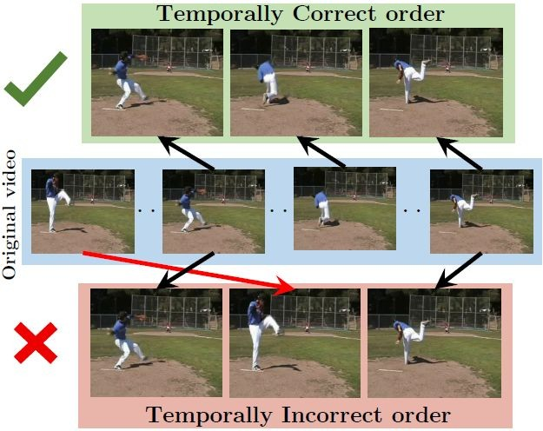
Self-supervision with temporal coherence
“With this simple task and no semantic labels, we learn a powerful visual representation using a Convolutional Neural Network (CNN).”
Misra et al., Shuffle and learn: unsupervised learning using temporal order verification. ECCV 2016
Common use cases in the video domain
Challenges in Video domain
Common approaches for video analysis
Self-supervision from videos
Video Summarization & scenes highlighting
32 / 45

Slide 33
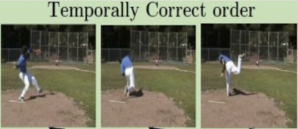
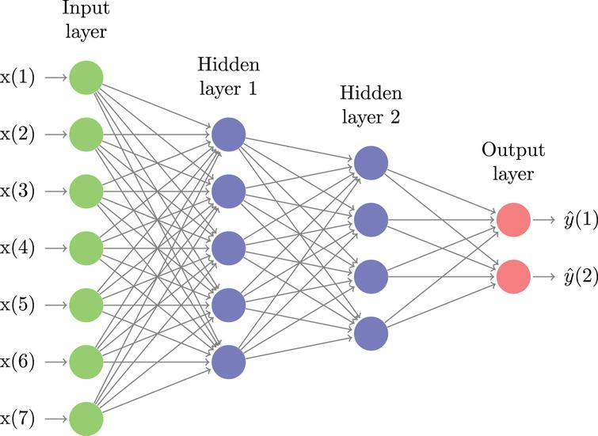
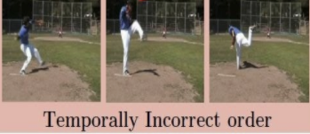
Self-supervision with temporal coherence
Label = 1
Binary classification model
Label = 0
Misra et al., Shuffle and learn: unsupervised learning using temporal order verification. ECCV 2016
Common use cases in the video domain
Challenges in Video domain
Common approaches for video analysis
Self-supervision from videos
Video Summarization & scenes highlighting
33 / 45
Notes:
what do we get from it?
understanding of the spatial and time domain

Slide 34
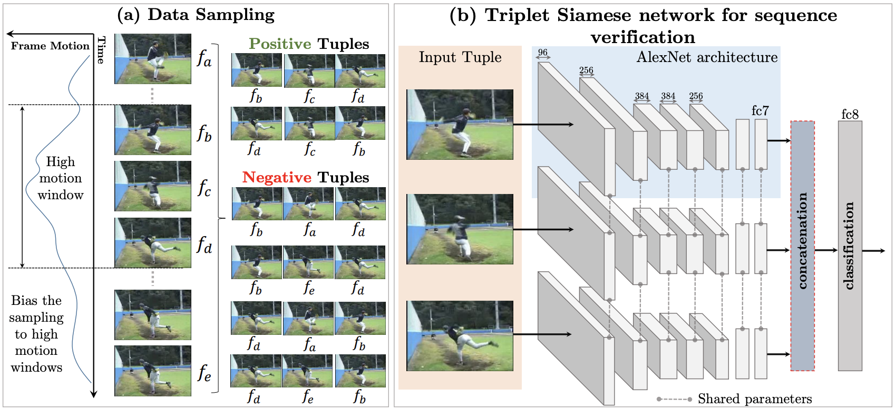
Self-supervision with Temporal coherence (advanced implementation)
We sample tuples of frames from high motion windows in a video. We form positive and negative tuples based on whether the three input frames are in the correct temporal order. (b) Our triplet Siamese network architecture has three parallel network stacks with shared weights upto the fc7 layer. Each stack takes a frame as input, and produces a representation at the fc7 layer. The concatenated fc7 representations are used to predict whether the input tuple is in the correct temporal order
Misra et al., Shuffle and learn: unsupervised learning using temporal order verification. ECCV 2016
Common use cases in the video domain
Challenges in Video domain
Common approaches for video analysis
Self-supervision from videos
Video Summarization & scenes highlighting
34 / 45
Notes:
is the anchor video is the

Slide 35
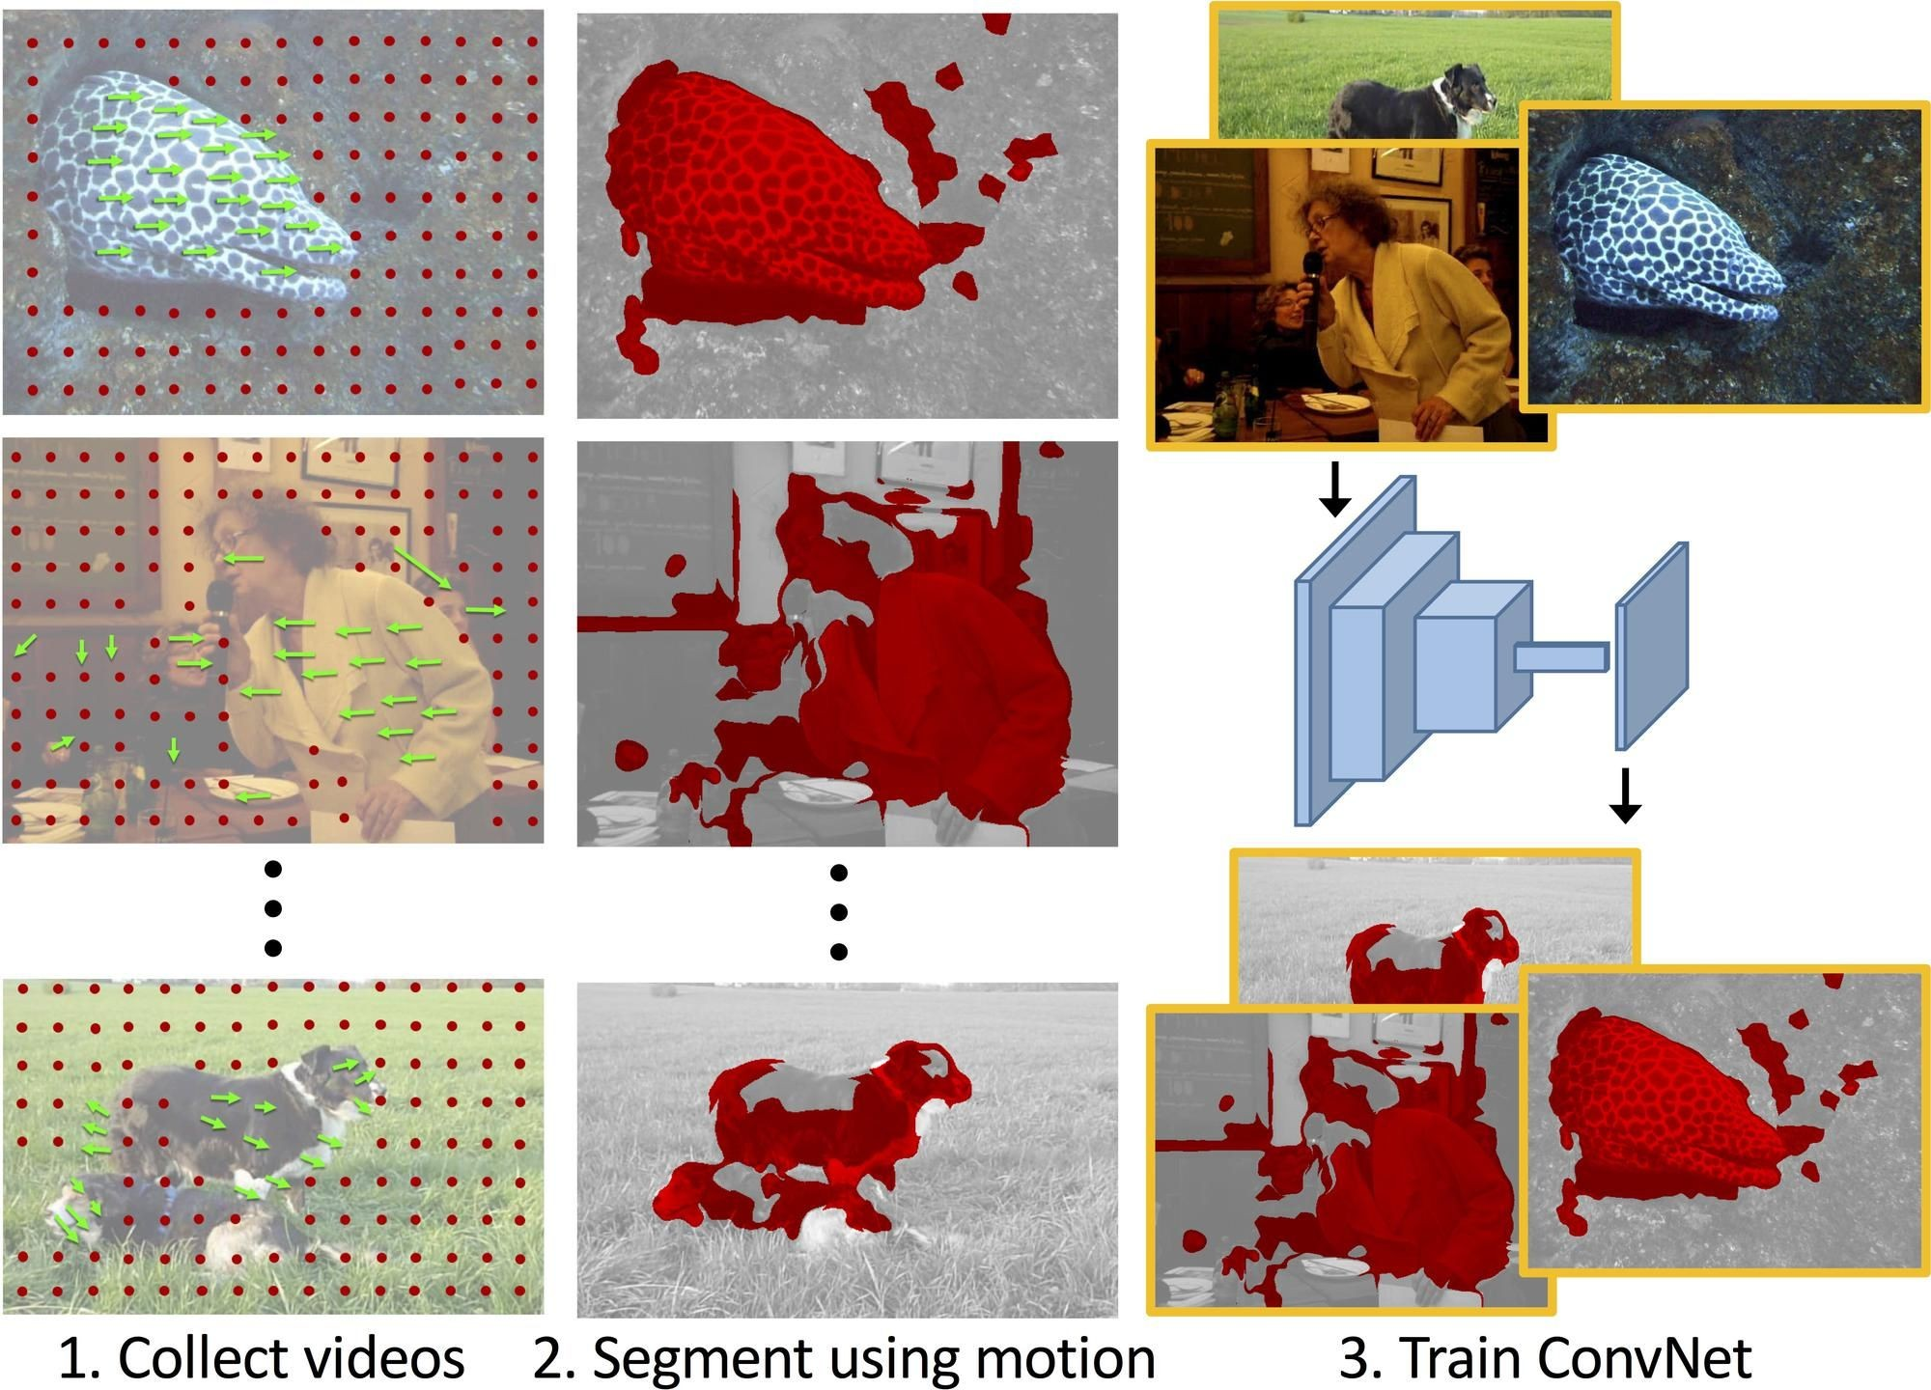
Self-supervision with motion as a proxy for foreground segmentation
“We use unsupervised motion-based segmentation on videos to obtain segments, which we use as 'pseudo ground truth' to train a convolutional network to segment objects from a single frame”
“When used for transfer learning on object detection, our representation significantly outperforms previous unsupervised approaches across multiple settings, especially when training data for the target task is scarce.”
Pathak et al., Learning features by watching objects move. CVPR 2017
Common use cases in the video domain
Challenges in Video domain
Common approaches for video analysis
Self-supervision from videos
Video Summarization & scenes highlighting
35 / 45

Slide 36
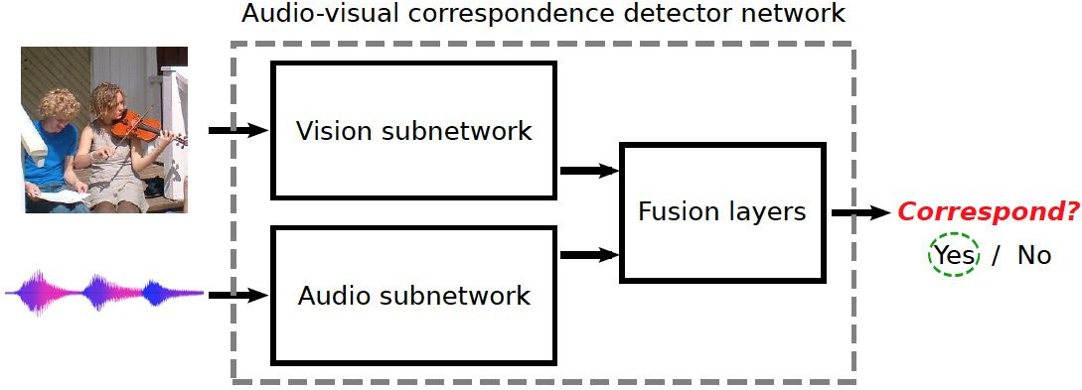
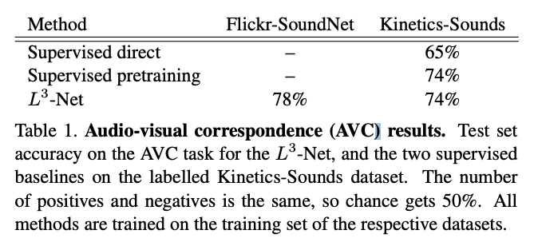
Self-supervision with correspondence between images and audio
Arandjelović & Zisserman. Look, Listen and Learn. ICCV 2017.
Common use cases in the video domain
Challenges in Video domain
Common approaches for video analysis
Self-supervision from videos
Video Summarization & scenes highlighting
36 / 45

Slide 37
Day agenda
Common use cases in the video domain
Challenges in Video domain
Common attitudes for video analysis
Self-supervision from videos
Video Summarization & scenes highlighting
Types of problems in Video domain
Challenges in Video domain
Common approaches for video analysis
Self-supervision from videos
Video Summarization & scenes highlighting
37 / 45

Slide 38
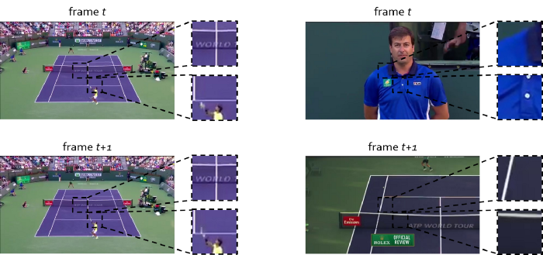
Exploit data redundancy - Scene Change Detection
The left panel shows two consecutive frames that do not represent a scene change.
The right panel shows two consecutive frames that do represent a scene change.
Comparing corresponding pixels in consecutive frames gives an indication of similarity
Common use cases in the video domain
Challenges in Video domain
Common approaches for video analysis
Self-supervision from videos
Video Summarization
& scenes highlighting
38 / 45

Slide 39
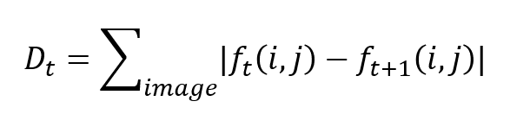
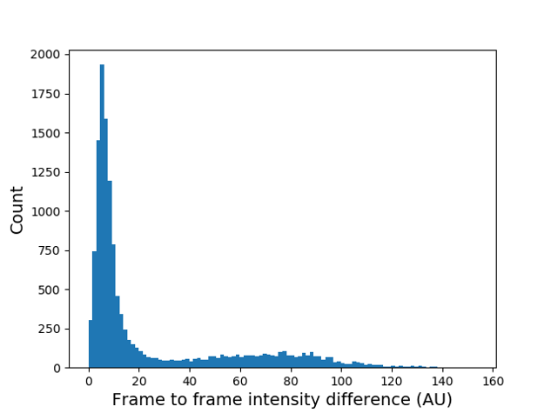
Exploit data redundancy - Scene Change Detection
This step is done by comparing corresponding pixels in consecutive frames. In mathematical terms, this is the first derivative of the frames. f_t(i,j) is the intensity of the frame t at location (i,j).
Common use cases in the video domain
Challenges in Video domain
Common approaches for video analysis
Self-supervision from videos
Video Summarization
& scenes highlighting
39 / 45
Notes:
https://medium.com/@tarhang/machine-learning-for-automatic-video-summary-generation-8a62d35105c6
where f_t(i,j) is the intensity of the frame t at location (i,j). Frames that do not represent a scene change end up with a small D_t. You can see below that ~90% of the frames have a relatively small D_t and also do not represent a scene change.

Slide 40
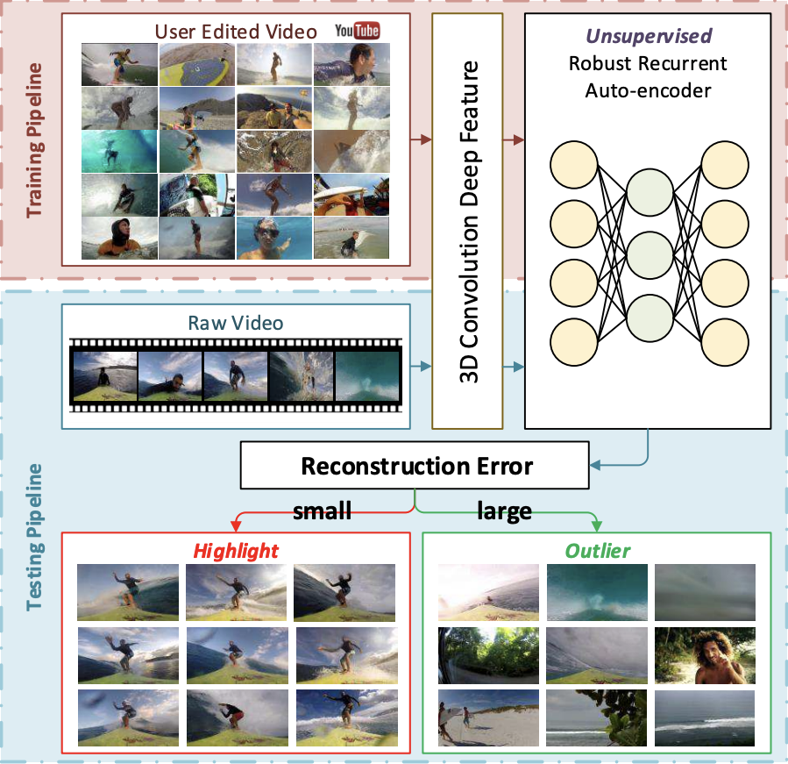
Unsupervised Extraction of Video Highlights Via Robust Recurrent Auto-encoders
This method can infer highlights using only a set of downloaded edited videos, without also needing their pre-edited counterparts.
Based on the idea that the most significant sub-events within a video class are commonly present among edited videos while less interesting ones appear less frequently, they identify the significant sub-events via a robust recurrent auto-encoder trained on a collection of user-edited videos queried for each particular class of interest.
Common use cases in the video domain
Challenges in Video domain
Common approaches for video analysis
Self-supervision from videos
Video Summarization & scenes highlighting
40 / 45
Notes:
https://www.microsoft.com/en-us/research/wp-content/uploads/2017/03/Yang_Unsupervised_Extraction_of_ICCV_2015_paper.pdf

Slide 41
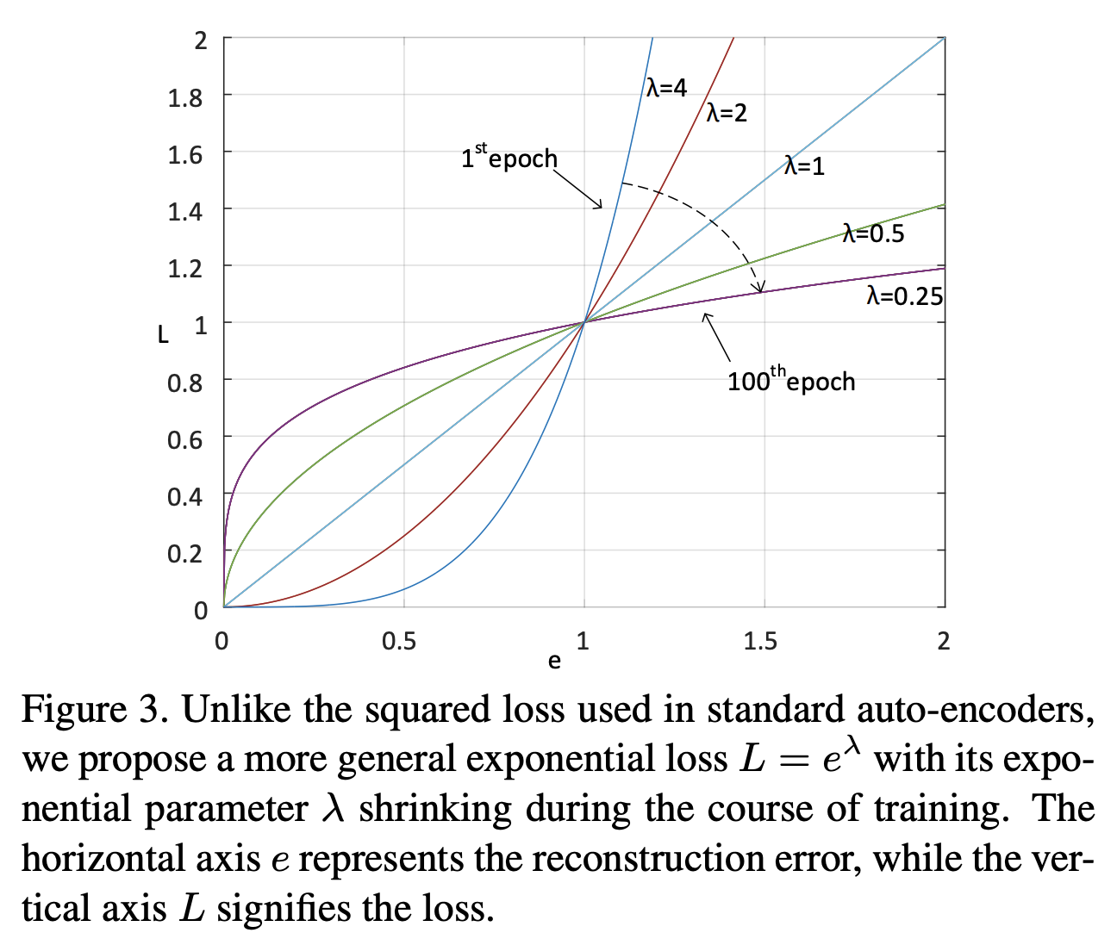
Unsupervised Extraction of Video Highlights Via Robust Recurrent Auto-encoders
The auto-encoder is trained using a proposed shrinking exponential loss function that makes it robust to noise in the web-crawled training data, and is configured with bidirectional long short term memory (LSTM) cells to better model the temporal structure of highlight segments.
Common use cases in the video domain
Challenges in Video domain
Common approaches for video analysis
Self-supervision from videos
Video Summarization & scenes highlighting
41 / 45

Slide 42
Unsupervised Extraction of Video Highlights Via Robust Recurrent Auto-encoders
Acquisition of Training Data: starts with a simple video crawling step.
Temporal Segmentation: A highlight can be defined as a motion or moment of interest with respect to the video domain context.
Feature Representation: features extracted at higher layers of a convolutional neural network are generic features that have good transfer learning capabilities across different domains.
Unsupervised Learning: Learn a discriminative model for highlight detection using a novel robust recurrent autoencoder
Common use cases in the video domain
Challenges in Video domain
Common approaches for video analysis
Self-supervision from videos
Video Summarization & scenes highlighting
42 / 45

Slide 43
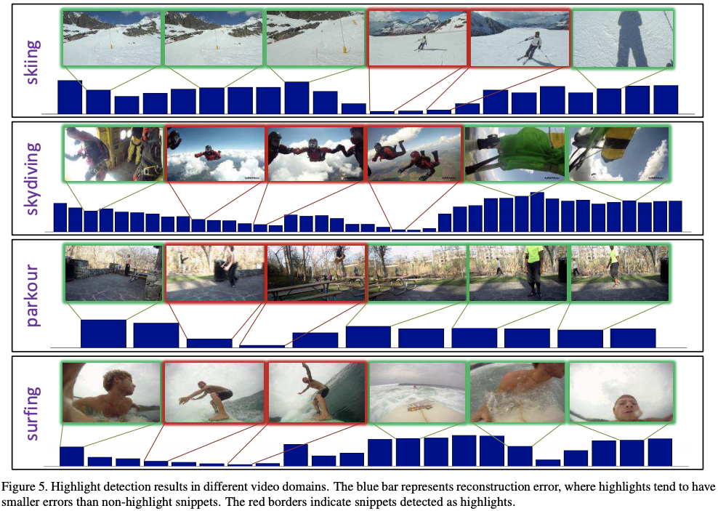
Unsupervised Extraction of Video Highlights Via Robust Recurrent Auto-encoders
Common use cases in the video domain
Challenges in Video domain
Common approaches for video analysis
Self-supervision from videos
Video Summarization & scenes highlighting
43 / 45

Slide 44
Exercise
Add combination layers after the cnn model
Add RNNs layers after the cnn model
Now, measure the same results after with pretrained cnn model
Now measure the same results after with self supervised training
44 / 45

Slide 45

Thank you for listening
You can reach me at ron@giveandtech.org.il
45 / 45

